Slide 1
بسم الله الرحمن الرحیم
Notes:
Introduce yourself
ان شاء الله که وخت خوب و پربرکت خواهیم داشت

Slide 2
CS101 Introduction to Computer Science

Slide 3
Lecture 10

Slide 4

Notes:
https://apps.apple.com/us/app/contacts/id1069512615#?platform=iphone
In Week 0, intuitive algorithms…
John Harvard

Slide 5
Notes:
https://apps.apple.com/us/app/contacts/id1069512615#?platform=iphone
In Week 0, intuitive algorithms…
John Harvard

Slide 6
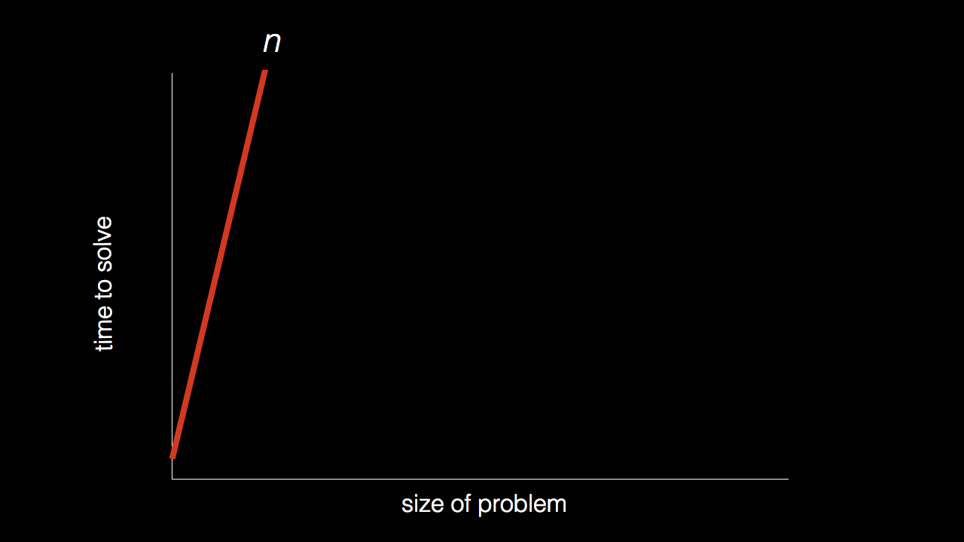
n

Slide 7
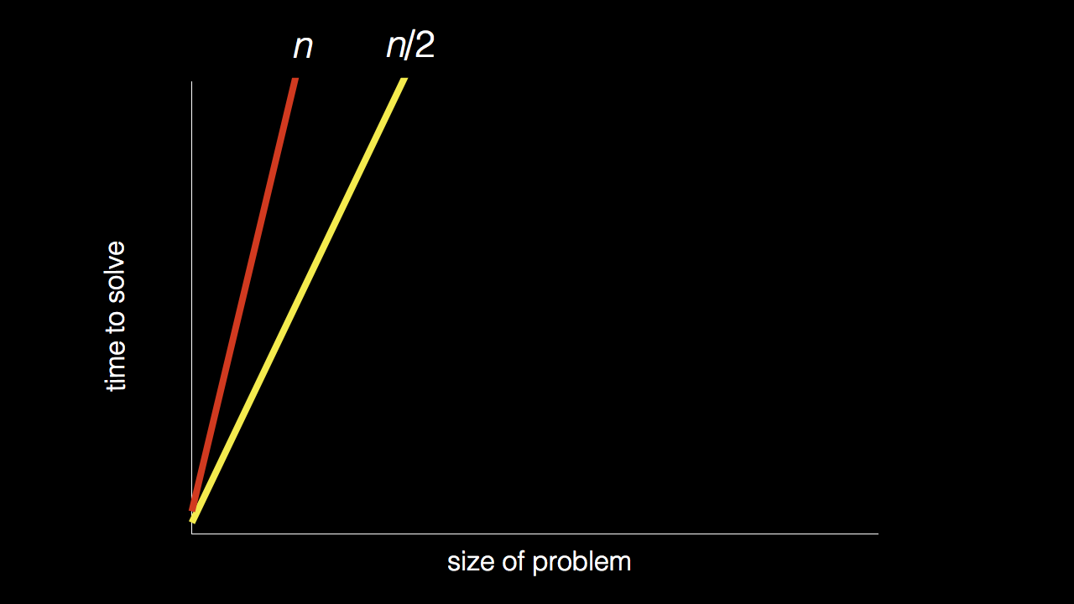
n
n/2

Slide 8
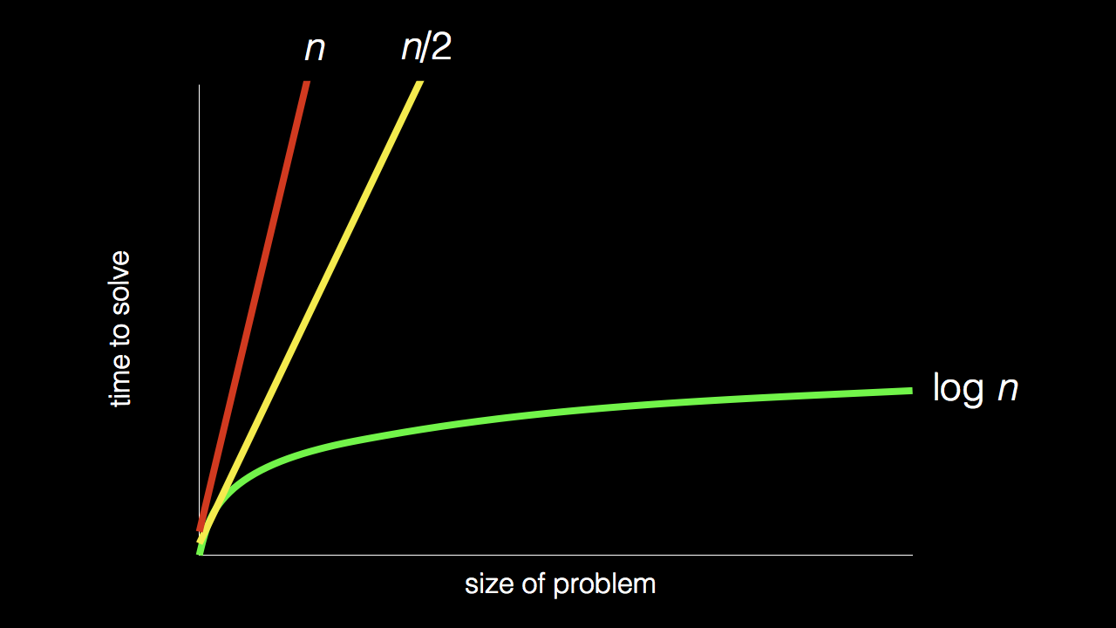
n
n/2
log₂ n

Slide 9
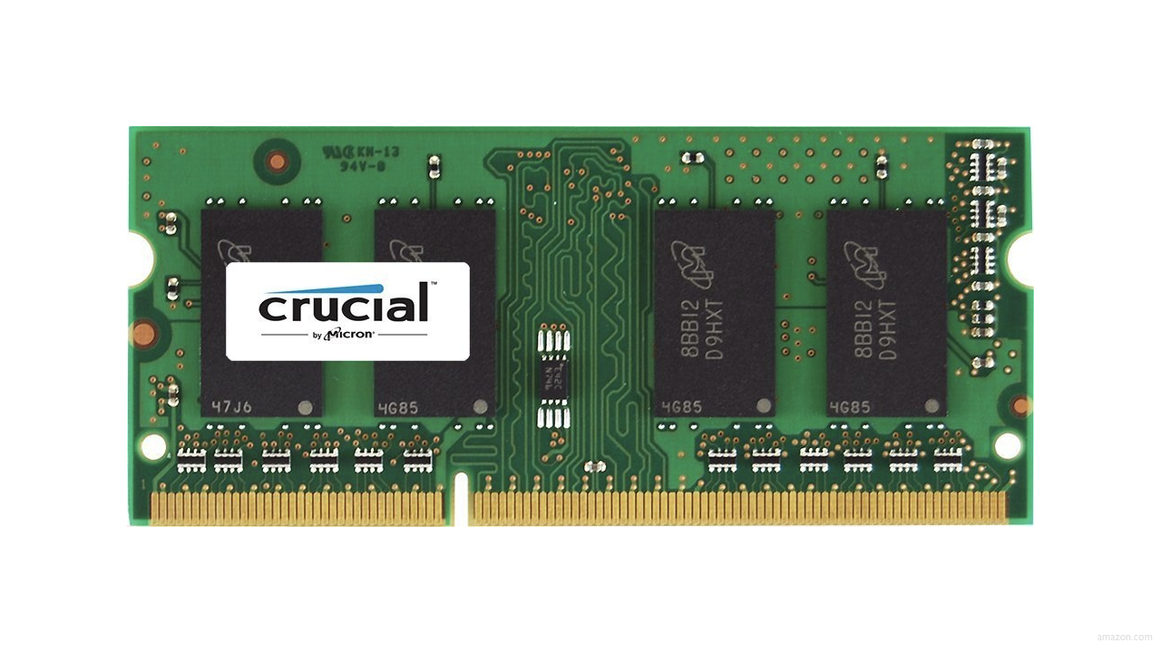

Slide 13
 | 1 | 5 | 10 | 20 | 50 | 100 | 500

Slide 15
 | [0] | [1] | [2] | [3] | [4] | [5] | [6]

Slide 16
 | [0] | [1] | [2] | [3] | [4] | [5] | [6]

Slide 17
searching

Slide 18
input →
→ output

Slide 19

→
→ output

Slide 20
→
→ bool

Slide 21
algorithm

Slide 22

Notes:
https://www.etsy.com/listing/926075105/monopoly-money-vintage-fabric-half-yard

Slide 23
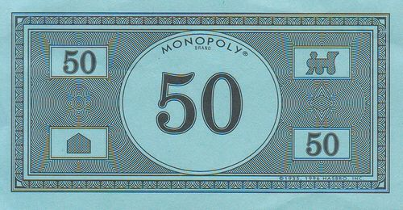
Notes:
https://www.pinterest.com/pin/525443481522247447/

Slide 24
linear search
Notes:
20 500 10 5 100 1 50

Slide 25
For each door from left to right
If 50 is behind door
Return true
Return false

Slide 26
For each door from left to right
If 50 is behind door
Return true
Else
Return false

Slide 27
For each door from left to right
If 50 is behind door
Return true
Return false

Slide 28
For i from 0 to n-1
If 50 is behind doors[i]
Return true
Return false

Slide 29
Notes:
https://www.pinterest.com/pin/525443481522247447/

Slide 30
binary search
Notes:
1 5 10 20 50 100 500

Slide 31
If 50 is behind middle door
Return true
Else if 50 < middle door
Search left half
Else if 50 > middle door
Search right half

Slide 32
If no doors left
If 50 is behind middle door
Return true
Else if 50 < middle door
Search left half
Else if 50 > middle door
Search right half

Slide 33
If no doors left
Return false
If 50 is behind middle door
Return true
Else if 50 < middle door
Search left half
Else if 50 > middle door
Search right half

Slide 34
If no doors left
Return false
If 50 is behind doors[middle]
Return true
Else if 50 < doors[middle]
Search doors[0] through doors[middle - 1]
Else if 50 > doors[middle]
Search doors[middle + 1] through doors[n - 1]

Slide 35
running time

Slide 36
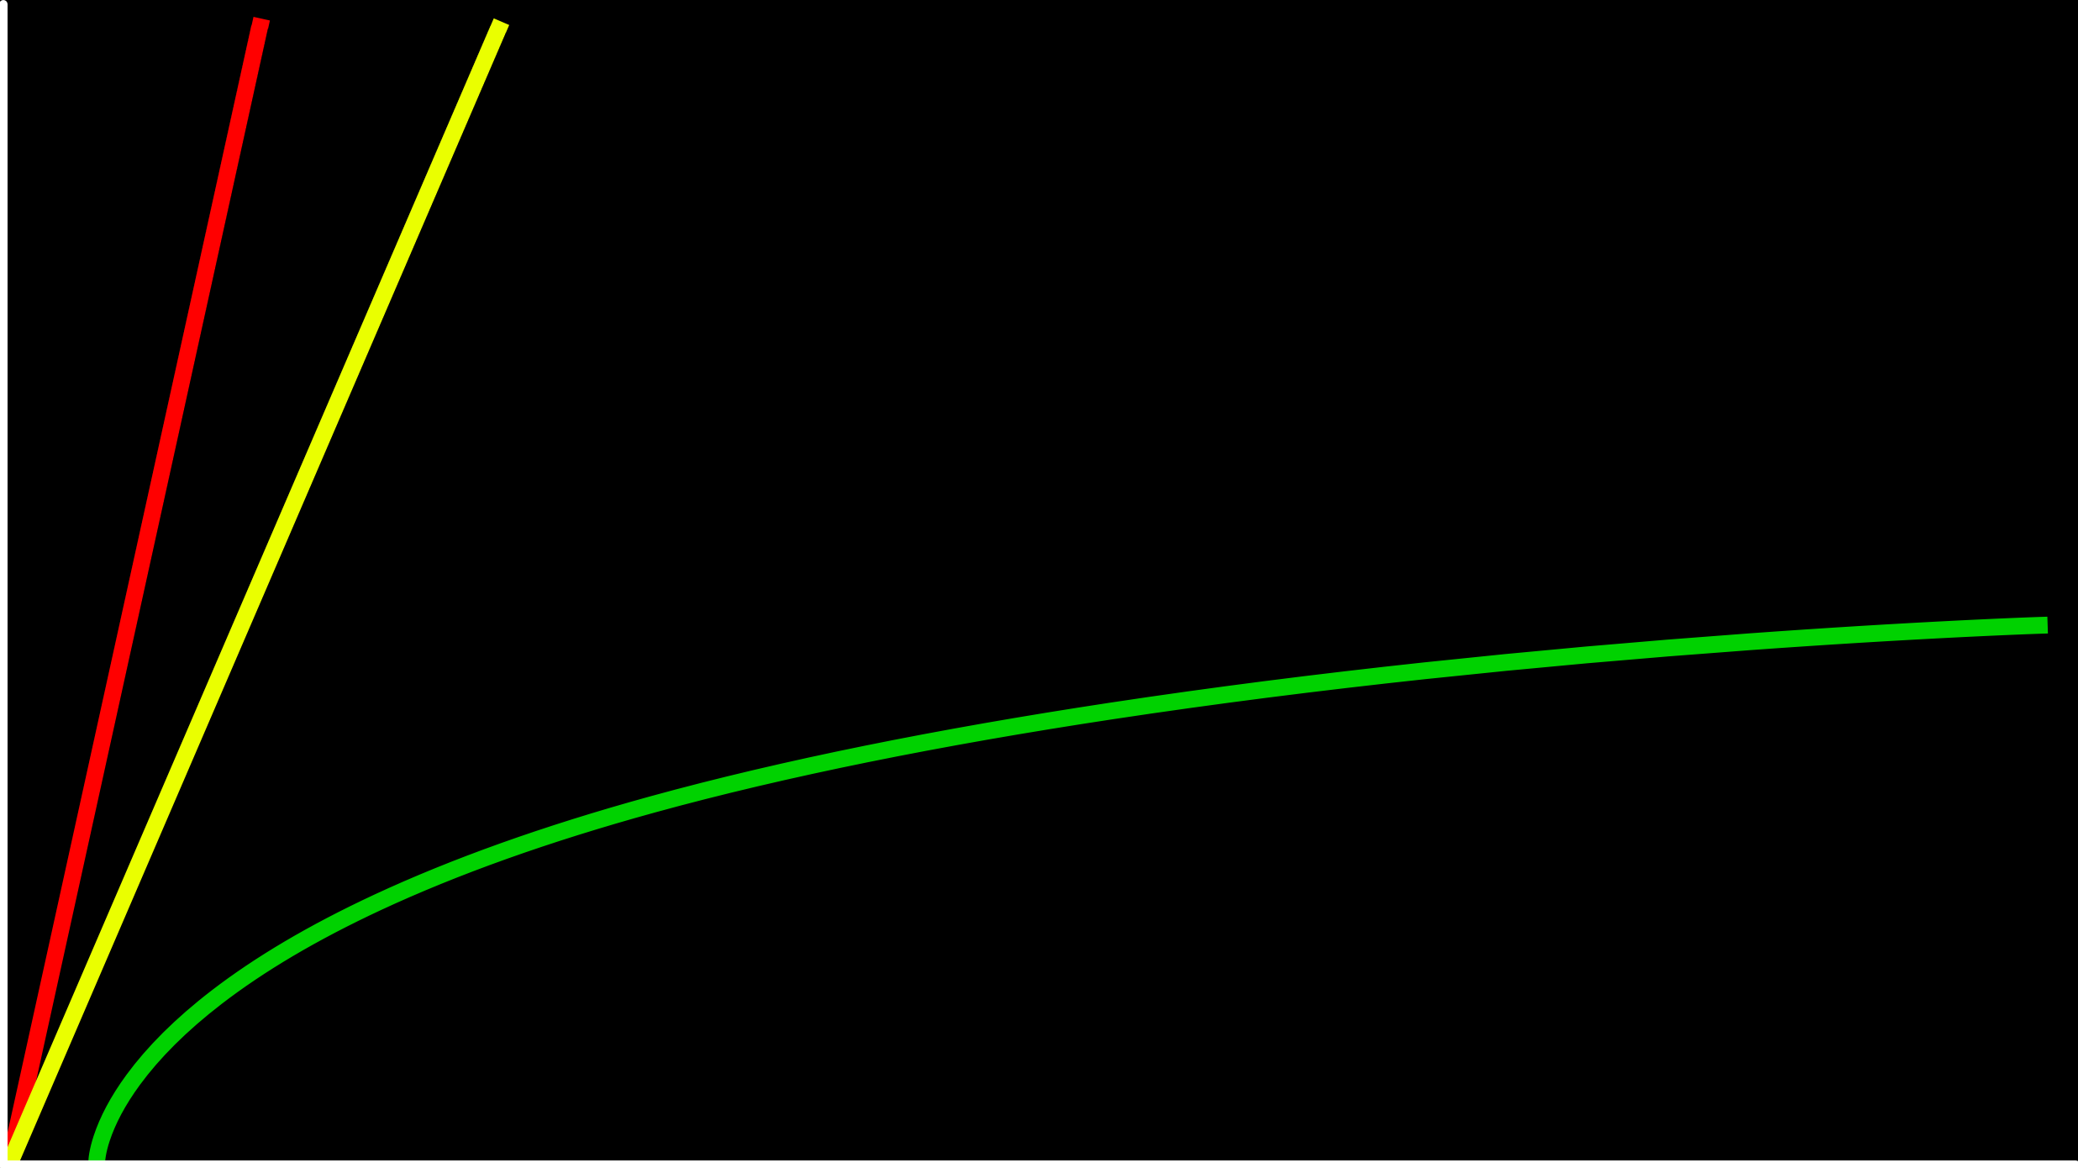
time to solve
size of problem

Slide 37
O(n)
O(n/2)
time to solve
O(log₂n)
size of problem

Slide 38
O(n)
O(n/2)
time to solve
O(log₂n)
size of problem

Slide 39
O(n)
O(n)
time to solve
O(log₂n)
size of problem

Slide 40
O(n)
O(n)
time to solve
O(log n)
size of problem

Slide 41
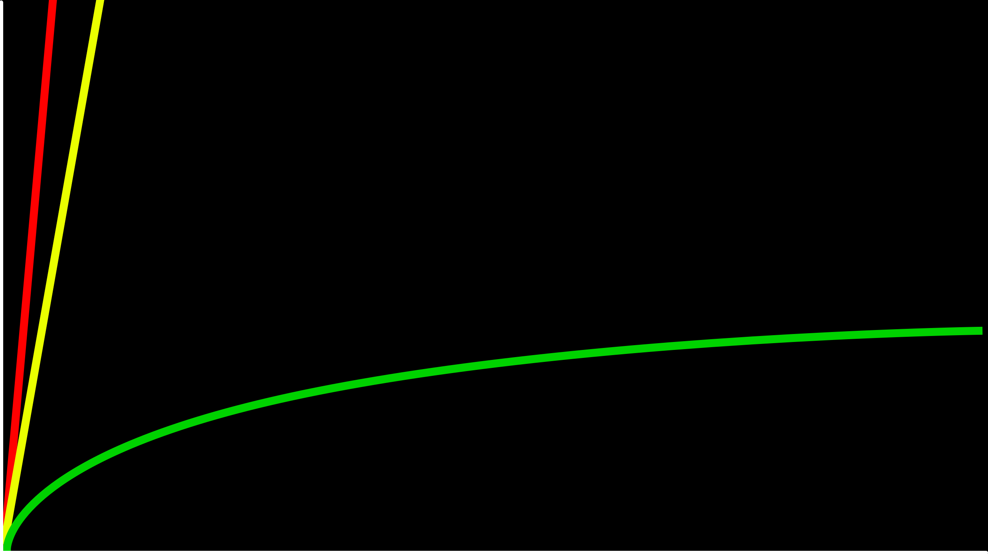
O(n)
time to solve
O(log n)
size of problem

Slide 42
O

Slide 43
O(n²)
O(n log n)
O(n)
O(log n)
O(1)
Notes:
linear? binary?

Slide 44
O(n²)
O(n log n)
O(n) linear search
O(log n)
O(1)

Slide 45
O(n²)
O(n log n)
O(n) linear search
O(log n) binary search
O(1)

Slide 46
Ω

Slide 47
Ω(n²)
Ω(n log n)
Ω(n)
Ω(log n)
Ω(1)
Notes:
linear? binary?

Slide 48
Ω(n²)
Ω(n log n)
Ω(n)
Ω(log n)
Ω(1) linear search

Slide 49
Ω(n²)
Ω(n log n)
Ω(n)
Ω(log n)
Ω(1) linear search, binary search

Slide 50
Θ

Slide 51
Θ(n²)
Θ(n log n)
Θ(n)
Θ(log n)
Θ(1)

Slide 52
asymptotic notation
Notes:
search{0,1}.c

Slide 53
linear search
Notes:
search{0,1}.c

Slide 54
string.h

Slide 55
manual.cs50.io/#string.h

Slide 56
strcmp
Notes:
phonebook0.c

Slide 57
data structures

Slide 58
person people[]

Slide 59
string name;
string number;

Slide 60
typedef struct
{
string name;
string number;
}
person;

Slide 61
typedef struct
{
string name;
string number;
} person;
Notes:
phonebook1.c
we'll see a way to save phonebook eventually

Slide 62
sorting

Slide 63
input →
→ output

Slide 64
unsorted →
→ output

Slide 65
unsorted →
→ sorted

Slide 66
→
→ sorted
7 2 5 4 1 6 0 3

Slide 67
→
→
7 2 5 4 1 6 0 3
0 1 2 3 4 5 6 7

Slide 68
7 2 5 4 1 6 0 3
Notes:
volunteers: sort themselves, then selection, then bubble

Slide 69
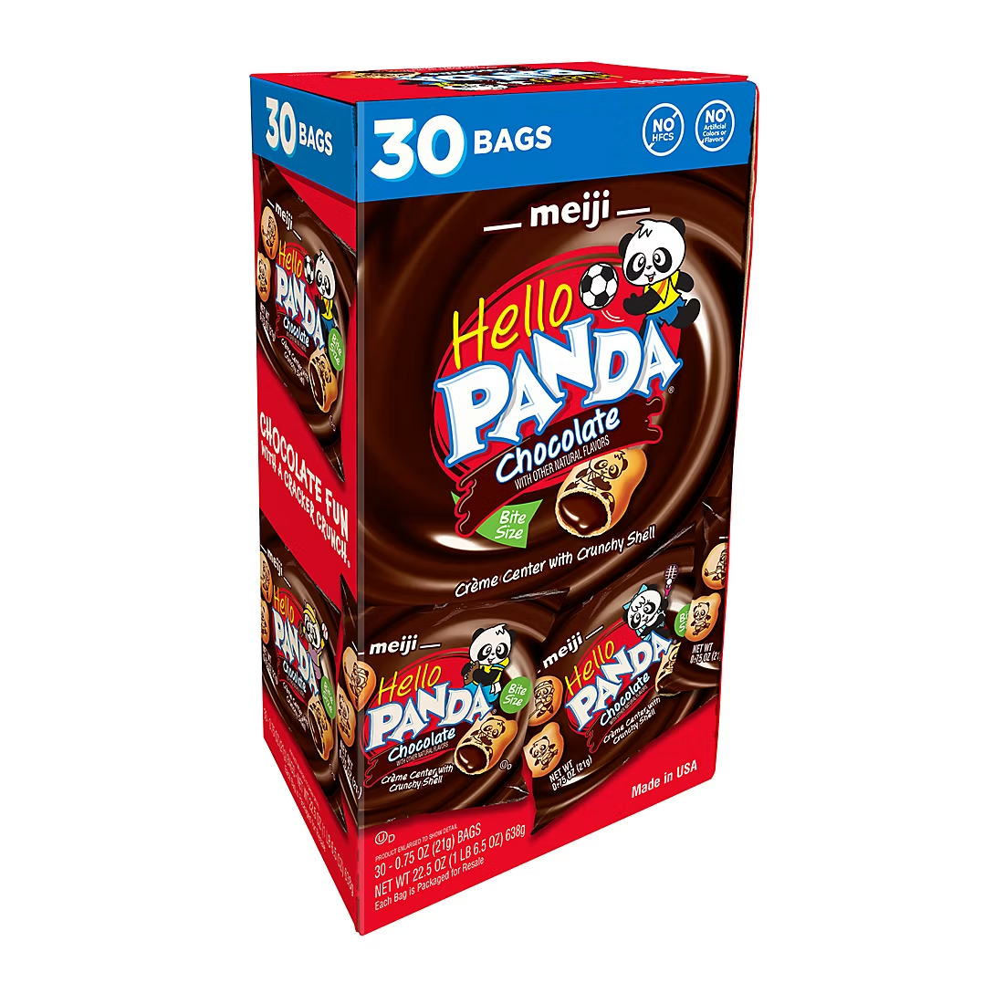

Slide 70
selection sort
Notes:
https://www.cs.usfca.edu/~galles/visualization/ComparisonSort.html

Slide 71
 | [0] | [1] | [2] | ... | [n-3] | [n-2] | [n-1]

Slide 72
For i from 0 to n-1
Find smallest number between numbers[i] and numbers[n-1]
Swap smallest number with numbers[i]

Slide 73
7 2 5 4 1 6 0 3

Slide 74
7 2 5 4 1 6 0 3
[i]

Slide 75
7 2 5 4 1 6 0 3
[i]
[i]
[n-1]

Slide 76
7 2 5 4 1 6 0 3
[i]
[i]
[n-1]

Slide 77
7 2 5 4 1 6 0 3
[i]
[i]
[n-1]

Slide 78
7 2 5 4 1 6 0 3
[i]
[i]
[n-1]

Slide 79
7 2 5 4 1 6 0 3
[i]
[i]
[n-1]

Slide 80
7 2 5 4 1 6 0 3
[i]
[i]
[n-1]

Slide 81
0 2 5 4 1 6 7 3
[i]
[i]
[n-1]

Slide 82
0 2 5 4 1 6 7 3
[i]
[i]
[n-1]

Slide 83
0 2 5 4 1 6 7 3
[i]
[i]
[n-1]

Slide 84
0 2 5 4 1 6 7 3
[i]
[n-1]

Slide 85
(n – 1)

Slide 86
(n – 1) + (n – 2)

Slide 87
(n – 1) + (n – 2) + (n – 3)

Slide 88
(n – 1) + (n – 2) + (n – 3) + ... + 1

Slide 89
(n – 1) + (n – 2) + (n – 3) + ... + 1
n(n – 1)/2

Slide 90
(n – 1) + (n – 2) + (n – 3) + ... + 1
n(n – 1)/2
(n² – n)/2

Slide 91
(n – 1) + (n – 2) + (n – 3) + ... + 1
n(n – 1)/2
(n² – n)/2
n²/2 – n/2

Slide 92
(n – 1) + (n – 2) + (n – 3) + ... + 1
n(n – 1)/2
(n² – n)/2
n²/2 – n/2
O(n²)

Slide 93
O(n²)
O(n log n)
O(n)
O(log n)
O(1)

Slide 94
O(n²) selection sort
O(n log n)
O(n)
O(log n)
O(1)

Slide 95
For i from 0 to n-1
Find smallest number between numbers[i] and numbers[n-1]
Swap smallest number with numbers[i]
Notes:
what about lower bound?

Slide 96
 | [0] | [1] | [2] | ... | [n-3] | [n-2] | [n-1]

Slide 97
Ω(n²)
Ω(n log n)
Ω(n)
Ω(log n)
Ω(1)

Slide 98
Ω(n²) selection sort
Ω(n log n)
Ω(n)
Ω(log n)
Ω(1)

Slide 99
Θ(n²)
Θ(n log n)
Θ(n)
Θ(log n)
Θ(1)

Slide 100
Θ(n²) selection sort
Θ(n log n)
Θ(n)
Θ(log n)
Θ(1)

Slide 101
bubble sort
Notes:
https://www.cs.usfca.edu/~galles/visualization/ComparisonSort.html

Slide 102
 | [0] | [1] | [2] | ... | [n-3] | [n-2] | [n-1]

Slide 103
Repeat n times
For i from 0 to n-2
If numbers[i] and numbers[i+1] out of order
Swap them

Slide 104
Repeat n-1 times
For i from 0 to n-2
If numbers[i] and numbers[i+1] out of order
Swap them

Slide 105
7 2 5 4 1 6 0 3

Slide 106
7 2 5 4 1 6 0 3
[i] [i+1]

Slide 107
2 7 5 4 1 6 0 3
[i] [i+1]

Slide 108
2 7 5 4 1 6 0 3
[i] [i+1]

Slide 109
2 5 7 4 1 6 0 3
[i] [i+1]

Slide 110
2 5 7 4 1 6 0 3
[i] [i+1]

Slide 111
2 5 4 7 1 6 0 3
[i] [i+1]

Slide 112
2 5 4 7 1 6 0 3
[i] [i+1]

Slide 113
2 5 4 1 7 6 0 3
[i] [i+1]

Slide 114
2 5 4 1 7 6 0 3
[i] [i+1]

Slide 115
2 5 4 1 6 7 0 3
[i] [i+1]

Slide 116
2 5 4 1 6 7 0 3
[i] [i+1]

Slide 117
2 5 4 1 6 0 7 3
[i] [i+1]

Slide 118
2 5 4 1 6 0 7 3
[i] [i+1]

Slide 119
2 5 4 1 6 0 3 7
[i] [i+1]

Slide 120
2 5 4 1 6 0 3 7
[i] [i+1]

Slide 121
Repeat n-1 times
For i from 0 to n-2
If numbers[i] and numbers[i+1] out of order
Swap them

Slide 122
Repeat n-1 times n-1
For i from 0 to n-2
If numbers[i] and numbers[i+1] out of order
Swap them

Slide 123
Repeat n-1 times n-1
For i from 0 to n-2 n-1
If numbers[i] and numbers[i+1] out of order
Swap them

Slide 124
Repeat n-1 times n-1
For i from 0 to n-2 n-1
If numbers[i] and numbers[i+1] out of order 1
Swap them

Slide 125
Repeat n-1 times n-1
For i from 0 to n-2 n-1
If numbers[i] and numbers[i+1] out of order 4
Swap them

Slide 126
Repeat n-1 times n-1
For i from 0 to n-2 n-1
If numbers[i] and numbers[i+1] out of order
Swap them

Slide 127
(n – 1) × (n – 1)

Slide 128
(n – 1) × (n – 1)
n² – 1n – 1n + 1

Slide 129
(n – 1) × (n – 1)
n² – 1n – 1n + 1
n² – 2n + 1

Slide 130
(n – 1) × (n – 1)
n² – 1n – 1n + 1
n² – 2n + 1
O(n²)

Slide 131
O(n²)
O(n log n)
O(n)
O(log n)
O(1)

Slide 132
O(n²) bubble sort
O(n log n)
O(n)
O(log n)
O(1)

Slide 133
Repeat n-1 times
For i from 0 to n-2
If numbers[i] and numbers[i+1] out of order
Swap them

Slide 134
Repeat n-1 times
For i from 0 to n-2
If numbers[i] and numbers[i+1] out of order
Swap them
If no swaps
Quit

Slide 135
Ω(n²)
Ω(n log n)
Ω(n)
Ω(log n)
Ω(1)

Slide 136
Ω(n²)
Ω(n log n)
Ω(n) bubble sort
Ω(log n)
Ω(1)

Slide 137
recursion

Slide 138
If no doors left
Return false
If number behind middle door
Return true
Else if number < middle door
Search left half
Else if number > middle door
Search right half

Slide 139
If no doors left
Return false
If number behind middle door
Return true
Else if number < middle door
Search left half
Else if number > middle door
Search right half

Slide 140
1 Pick up phone book
2 Open to middle of phone book
3 Look at page
4 If person is on page
5 Call person
6 Else if person is earlier in book
7 Open to middle of left half of book
8 Go back to line 3
9 Else if person is later in book
10 Open to middle of right half of book
11 Go back to line 3
12 Else
13 Quit

Slide 141
1 Pick up phone book
2 Open to middle of phone book
3 Look at page
4 If person is on page
5 Call person
6 Else if person is earlier in book
7 Open to middle of left half of book
8 Go back to line 3
9 Else if person is later in book
10 Open to middle of right half of book
11 Go back to line 3
12 Else
13 Quit

Slide 142
1 Pick up phone book
2 Open to middle of phone book
3 Look at page
4 If person is on page
5 Call person
6 Else if person is earlier in book
7 Open to middle of left half of book
8 Go back to line 3
9 Else if person is later in book
10 Open to middle of right half of book
11 Go back to line 3
12 Else
13 Quit

Slide 143
1 Pick up phone book
2 Open to middle of phone book
3 Look at page
4 If person is on page
5 Call person
6 Else if person is earlier in book
7 Search left half of book
8
9 Else if person is later in book
10 Search right half of book
11
12 Else
13 Quit

Slide 144
1 Pick up phone book
2 Open to middle of phone book
3 Look at page
4 If person is on page
5 Call person
6 Else if person is earlier in book
7 Search left half of book
8 Else if person is later in book
9 Search right half of book
10 Else
11 Quit

Slide 145

Notes:
http://ian-albert.com/games/super_mario_bros_maps/

Slide 146

Notes:
iteration.c

Slide 147


Slide 148


Slide 149


Slide 150

Notes:
recursion.c

Slide 151
google.com/search?q=recursion

Slide 152
merge sort

Slide 153
Sort left half of numbers
Sort right half of numbers
Merge sorted halves

Slide 154
If only one number
Quit
Else
Sort left half of numbers
Sort right half of numbers
Merge sorted halves

Slide 155
If only one number
Quit
Else
Sort left half of numbers
Sort right half of numbers
Merge sorted halves

Slide 156
1 3 4 6 0 2 5 7
Notes:
shelves

Slide 157
If only one number
Quit
Else
Sort left half of numbers
Sort right half of numbers
Merge sorted halves
Notes:
https://www.cs.usfca.edu/~galles/visualization/ComparisonSort.html

Slide 158
6 3 4 1 5 2 7 0
Notes:
shelves

Slide 159
6 | 3 | 4 | 1 | 5 | 2 | 7 | 0

Slide 160
6 | 3 | 4 | 1 | 5 | 2 | 7 | 0

Slide 161
 |  |  |  | 5 | 2 | 7 | 0
6 | 3 | 4 | 1

Slide 162
 |  |  |  | 5 | 2 | 7 | 0
 |  | 4 | 1
6 | 3

Slide 163
 |  |  |  | 5 | 2 | 7 | 0
 |  | 4 | 1
 | 3
6

Slide 164
 |  |  |  | 5 | 2 | 7 | 0
 |  | 4 | 1
6
3

Slide 165
 |  |  |  | 5 | 2 | 7 | 0
 |  | 4 | 1
3
6

Slide 166
 |  |  |  | 5 | 2 | 7 | 0
 |  | 4 | 1
3 | 6

Slide 167
 |  |  |  | 5 | 2 | 7 | 0
3 | 6
4 | 1

Slide 168
 |  |  |  | 5 | 2 | 7 | 0
3 | 6
 | 1
4

Slide 169
 |  |  |  | 5 | 2 | 7 | 0
3 | 6
4
1

Slide 170
 |  |  |  | 5 | 2 | 7 | 0
3 | 6
1
4

Slide 171
 |  |  |  | 5 | 2 | 7 | 0
3 | 6
1 | 4

Slide 172
 |  |  |  | 5 | 2 | 7 | 0
1
3 | 6
 | 4

Slide 173
 |  |  |  | 5 | 2 | 7 | 0
1 | 3
 | 6
 | 4

Slide 174
 |  |  |  | 5 | 2 | 7 | 0
1 | 3 | 4
 | 6

Slide 175
 |  |  |  | 5 | 2 | 7 | 0
1 | 3 | 4 | 6

Slide 176
1 | 3 | 4 | 6
5 | 2 | 7 | 0

Slide 177
1 | 3 | 4 | 6
 |  | 7 | 0
5 | 2

Slide 178
1 | 3 | 4 | 6
 |  | 7 | 0
 | 2
5

Slide 179
1 | 3 | 4 | 6
 |  | 7 | 0
5
2

Slide 180
1 | 3 | 4 | 6
 |  | 7 | 0
2
5

Slide 181
1 | 3 | 4 | 6
 |  | 7 | 0
2 | 5

Slide 182
1 | 3 | 4 | 6
2 | 5
7 | 0

Slide 183
1 | 3 | 4 | 6
2 | 5
 | 0
7

Slide 184
1 | 3 | 4 | 6
2 | 5
7
0

Slide 185
1 | 3 | 4 | 6
2 | 5
0
7

Slide 186
1 | 3 | 4 | 6
2 | 5
0 | 7

Slide 187
1 | 3 | 4 | 6
0
2 | 5
 | 7

Slide 188
1 | 3 | 4 | 6
0 | 2
 | 5
 | 7

Slide 189
1 | 3 | 4 | 6
0 | 2 | 5
 | 7

Slide 190
1 | 3 | 4 | 6
0 | 2 | 5 | 7

Slide 191
0
1 | 3 | 4 | 6
 | 2 | 5 | 7

Slide 192
0 | 1
 | 3 | 4 | 6
 | 2 | 5 | 7

Slide 193
0 | 1 | 2
 | 3 | 4 | 6
 |  | 5 | 7

Slide 194
0 | 1 | 2 | 3
 |  | 4 | 6
 |  | 5 | 7

Slide 195
0 | 1 | 2 | 3 | 4
 |  |  | 6
 |  | 5 | 7

Slide 196
0 | 1 | 2 | 3 | 4 | 5
 |  |  | 6
 |  |  | 7

Slide 197
0 | 1 | 2 | 3 | 4 | 5 | 6
 |  |  | 7

Slide 198
0 | 1 | 2 | 3 | 4 | 5 | 6 | 7

Slide 199
0 | 1 | 2 | 3 | 4 | 5 | 6 | 7

Slide 200
O(n²)
O(n log n)
O(n)
O(log n)
O(1)

Slide 201
6 | 3 | 4 | 1 | 5 | 2 | 7 | 0
6 | 3 | 4 | 1
5 | 2 | 7 | 0
6 | 3
4 | 1
5 | 2
7 | 0
6
3
4
1
5
2
7
0

Slide 202
6 | 3 | 4 | 1 | 5 | 2 | 7 | 0
6 | 3 | 4 | 1
5 | 2 | 7 | 0
6 | 3
4 | 1
5 | 2
7 | 0
6
3
4
1
5
2
7
0

Slide 203
log₂ n

Slide 204
log₂ 8

Slide 205
log₂ 2³

Slide 206
3

Slide 207
6 | 3 | 4 | 1 | 5 | 2 | 7 | 0
6 | 3 | 4 | 1
5 | 2 | 7 | 0
6 | 3
4 | 1
5 | 2
7 | 0
6
3
4
1
5
2
7
0

Slide 208
n log₂ n

Slide 209
n log n

Slide 210
O(n²)
O(n log n) merge sort
O(n)
O(log n)
O(1)

Slide 211
Ω(n²)
Ω(n log n) merge sort
Ω(n)
Ω(log n)
Ω(1)

Slide 212
Θ(n²)
Θ(n log n) merge sort
Θ(n)
Θ(log n)
Θ(1)

Slide 213
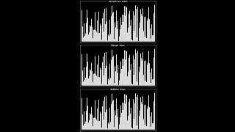
Notes:
Source: https://www.youtube.com/watch?v=ZZuD6iUe3Pc
https://www.youtubeeducation.com/watch?v=3WDWH59k1q4

Slide 214

Notes:
Reload codespace
Uncheck VS Code tabs

